Slide 1



Slide 2

Heap and Hash File Organization
Database System
Assignment - 03

Slide 3

T H E T E A M
Syed Faateh Sultan Kazmi (BCSF18M022)
Muhammad Afaq Shuaib (BCSF18M004)
Muhammad Bilal (BCSF18M029)

Slide 4
Introduction to File Organization

Slide 5

File Organization
What is File?
A file is a named collection of related information that is recorded on secondary storage such as magnetic disks, magnetic tables and optical disks. Basically, file is an object on a computer that stores data, information, settings, or commands used with a computer program.
File organization is a logical relationship among various records. This method defines how file records are mapped onto disk blocks. Storing the files in certain order is called file Organization.
File organization is used to describe the way in which the records are stored in terms of blocks, and the blocks are placed on the storage medium. The first approach to map the database to the file is to use the several files and store only one fixed length record in any given file. An alternative approach is to structure our files so that we can contain multiple lengths for records.

Slide 6
Objectives of File Organization

Slide 7
Objectives – File Organization
It contains an optimal selection of records, i.e., records can be selected as fast as possible.
To perform insert, delete or update transaction on the records should be quick and easy.
The duplicate records cannot be induced as a result of insert, update or delete.
For the minimal cost of storage, records should be stored efficiently.

Slide 8
Types of File Organization

Slide 9
Types – File Organization
The type and frequency of access can be determined by the type of file organization which was used for a given set of records.
Several types of File Organizations are:
Sequential File Organization
Heap File Organization
Hash File Organization
B+ Tree File Organization
Clustered File Organization

Slide 10
Heap File Organization - Introduction

Slide 11
Introduction - Heap File Organization
It is the simplest and most basic type of organization.
works with data blocks (the smallest unit of data used by a database).
In heap file organization, the records are inserted at the file's end. When the records are inserted, it doesn't require the sorting and ordering of records.
When the data block is full, the new record is stored in some other block. . It is now the Data Base Management System (DBMS) responsibility to store and manage the new records.
The heap file is also known as an unordered file as there is no ordering of record in the data because on every insert data is to be inserted at the end of the file.
In heap file, every record has a unique id, and every page or every data block of a file is of the same size.

Slide 12
Heap File Organization - Operations

Slide 13
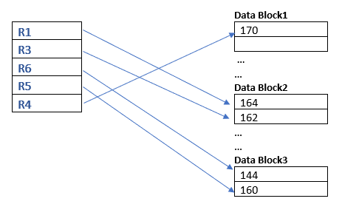
Heap File Organization - Example
Lets suppose we have records R1, R3, R6, R5, R4 in our heap file and data block2, data block3 are full.

Slide 14
Heap File Organization - Insertion
Suppose that we want to insert a record R2 in the database shown in the previous slide. It is evident that data block 3 is full so it will be inserted in any of the database selected by the DBMS, let's say data block 1.
If there is some space available in data block 3 then it will be inserted in data block 3 Because by default the record is inserted at the end of the file.

Slide 15
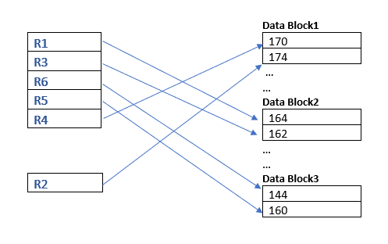
Heap File Organization - Insertion

Slide 16
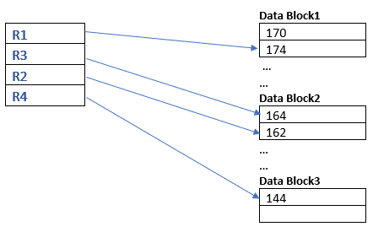
Heap File Organization - Example
Suppose that now we have following records(R1, R3, R2, R4) in the heap.

Slide 17
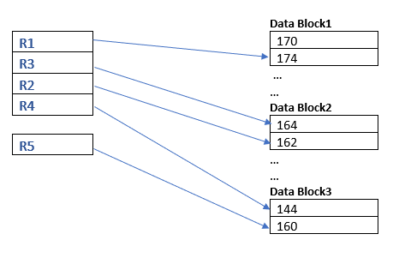
Heap File Organization - Insertion
And now we want to add the new record let say ‘R5’ in the heap. As you know in the heap file organization the new record is to be inserted at the end of the file. So, the next record is to be entered in the Data block 3 the place after where R4 is stored.

Slide 18
Heap File Organization - Searching
Linear searching is used in searching of the record in the heap file, because in heap file organization no specific order is maintained between the records. You have to traverse the records until the required searched account is found, because there is no particular ordering took into account while inserting the records in the heap file structure.

Slide 19
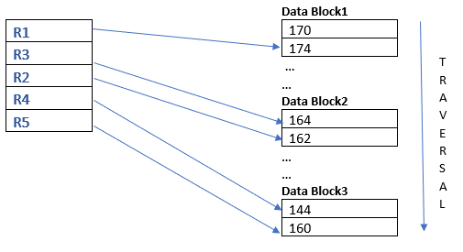
Heap File Organization - Searching
If you have to find R4 record in the heap, you have to traverse all the records of Data block 1, Data block 2 and in Data block 3 at the first place you find your record. You have to traverse empty memory space also in a data block because if any record is deleted it creates a gap there and there is no record present. So, you have to traverse these memory location also until you find your required searching record.

Slide 20
Heap File Organization - Deletion
If we want to delete a record from the heap file then the required data has to accessed and then marked that record to be deleted. (Linear Searching used)
Deletion of the record would create an empty space in the data block where the searched record is found.
Frequent deletion of records would create much free space in a file, and this need periodical reorganization of the file.

Slide 21
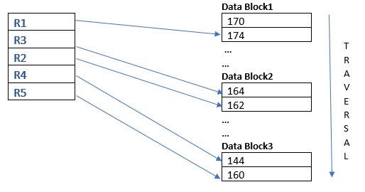
Heap File Organization - Deletion
For example, If I want to delete to delete the Record ‘R4’, so first we have to search for R4 in data blocks(pages) of the file, after traversing two whole Data blocks (Data block 1,2) at the first position of the data block3 we found our Record R4. Now we have to delete that record which creates a free space in a file.

Slide 22
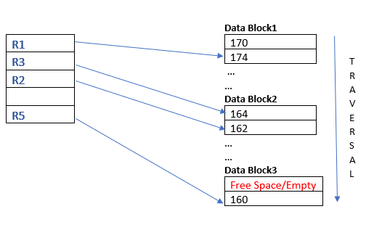
Heap File Organization - Deletion

Slide 23
Heap File Organization - Modification
Similarly, for the modification of records in the heap file structure you to have first search for that particular record in the file which means you have to traverse all the records until you read your required record having some unique id. Then you update the required record.

Slide 24
Heap File Organization – Pros and Cons

Slide 25
Heap File Organization - Pros
Efficient Accessing of Records( For smaller Database Systems): For the smaller database systems users can access the records rapidly than the sequential file organization.
Loading of Large Amount of Data in the database: It is the best method for loading a large amount of data in the database at a time.
Easy Insertion of Records: Insertion becomes easy in heap file organization because every record is to be inserted at the end of the file.

Slide 26
Heap File Organization - Cons
Slow Retrieval of records: As a heap file uses no particular ordering, we are able to locate the required record using linear search only. It would take more time and make retrieval slow.
Non Efficient (for Large Database System) It is not efficient for the large database systems because this method takes more time for performing the operation on the data. Like deletion, searching, updating of record.
File Reorganization Frequent deletions of records would need periodical file reorganization.
Memory Management To boost the performance, proper memory management is required. This is the extra overhead in handling records. The main disadvantage of this file organization is that there is a problem with an unused block of memory.

Slide 27
Hash File Organization - Introduction

Slide 28
Introduction – Hash File Organization
Hash file organization is also called direct or random file organization.
Uses hash functions to generate the address of the data blocks in which the records are stored.
This type of organization does not need an index structure.
It is an efficient technique to directly search the location of the required record on the hard disk.
The hash function can be either a simple or complex mathematical function.

Slide 29
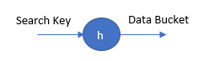
Introduction – Hash File Organization
The following terms are used in this type of file organization:
Data Bucket/Block: The location on the hard drive where records are stored. These are also called unit of storage.
Hash Function: A function that is used to map the set of search keys to actual record address. Defined by h.
Hash Key: The key that is given input to the hash function which then generates the record address.

Slide 30
Hash File Organization – Hash Functions

Slide 31
Hash File Organization – Hash Functions
There are three types of hashing functions:
Cut Key Function: We cut a portion of the field that is used, for example if EMPNO is used, we can cut the first three digits of each EMPNO in order to get hash key. For example: 7369 will become 9.
Folded Key: This type of key performs a mathematical operation on each of the digits of the field and make the resulting value the hash key. For example: 7369 will become 7+3+6+9: 17.
Division Remainder Key: This type of key uses a mod value and generates the hash key by considering the remainder of the field when divided by the mode value. For example: 7369 with mod value 9 will become: 7.

Slide 32
Hash File Organization – Operations

Slide 33
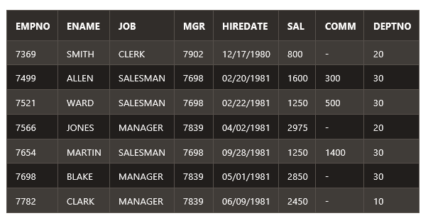
Hash File Organization - Example
When a new record is inserted into the table, The hash function h generates a bucket address for the new record based on its hash key K. Bucket address = h(K). Suppose that we want to store the following table using Hash File Organization.

Slide 34
Hash File Organization - Insertion
The hash function for it is mod 9. We use the primary key EMPNO as input for the hash function. As in hash function, we are taking mod by 9, so the total number of data blocks are 9.
For 1st record: 7369 mod 9 = 7, The first record is stored in 7th data bucket.
For 2nd record: 7499 mod 9 = 2, The second record is stored in 2nd data bucket.
For 3rd record: 7521 mod 9 = 6, The third record is stored in 6th data bucket.
For 4th record: 7566 mod 9 = 6, The fourth record is stored in 6th data bucket.
For 5th record: 7654 mod 9 = 6, The fifth record is stored in 6th data bucket.
For 6th record: 7698 mod 9 = 3, The sixth record is stored in 3rd data bucket.
For 7th record: 7782 mod 9 = 6, The seventh record is stored in 6th data bucket.

Slide 35
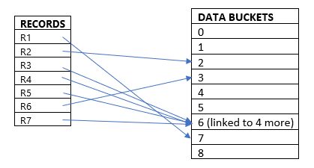
Hash File Organization - Insertion

Slide 36
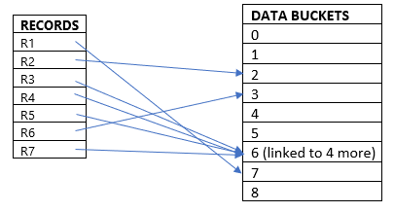
Hash File Organization - Searching
When a record needs to be searched, The same hash function is used to retrieve the bucket address for the record. For Example, if we want to retrieve whole record for EMPNO 7369, we will use the hash function mod 9 and get 7. After going to the 7th data bucket, we will retrieve the whole record for EMPNO 7369.
7th data bucket

Slide 37
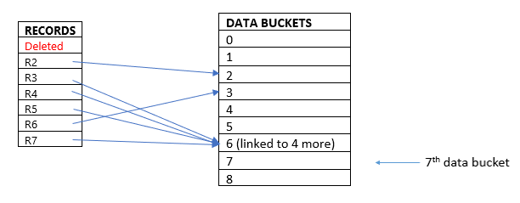
Hash File Organization - Deletion
If we want to delete a record, Using the hash function we will first fetch the record which is supposed to be deleted. Then we will remove the records for that address in memory. For example, we want to remove the record with EMPNO 7369:

Slide 38
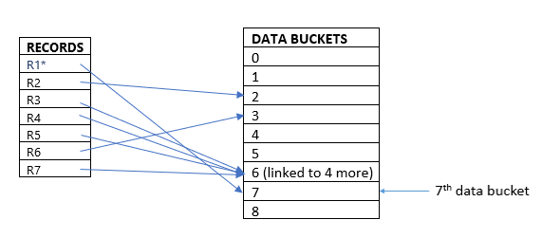
Hash File Organization - Modification
The data record that needs to be updated is first searched using hash function, and then the data record is updated. For example, we want to update the record with EMPNO 7369:

Slide 39
Hash File Organization – Types of Hashing

Slide 40
Hash File Organization – Types of Hashing
There are two types of hashing:
Static Hashing: Further subdivided into:
Open Hashing
Closed Hashing
Dynamic Hashing

Slide 41
Hash File Organization – Static Hashing
In this type of hashing, the number of data buckets always remains the same.
The hash function always computes the same address for a particular record.
For example: for EMPNO = 7369 with mod 9 hash function will always generate 7. There will not be any changes to the data bucket address.
If the number of data buckets always remain the same, at some point all the buckets will be full and there will remain no empty space. This is called bucket overflow and can be fixed using the following methods:
Open Hashing
Closed Hashing

Slide 42
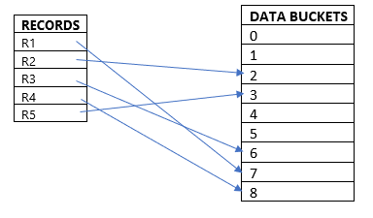
Hash File Organization – Open Hashing
If the hash function returns an address that is already filled, the system searches for the next empty slot and then that record is stored at the next available space.
Suppose that the address generated for the record R4 is 6 which is already filled, the system searches for the next free slot and links the record to that address i.e. 8. This method is also called Linear Probing.

Slide 43
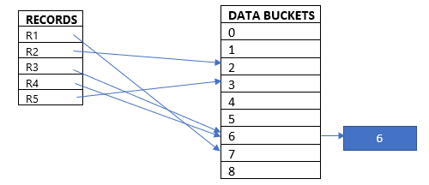
Hash File Organization – Closed Hashing
In this type of hashing, a new data bucket is allocated with same address and is linked to the filled data bucket much similar to a linked list.
Suppose that the address generated for the record R4 is 6 which is already filled, the system allocates a new data bucket and links it to the already filled data bucket. This method is also called Overflow Chaining.

Slide 44
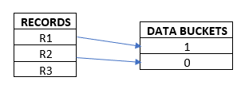
Hash File Organization – Dynamic Hashing
In this type of hashing, the size of data buckets can vary.
The data buckets grow or shrink (added or removed dynamically) as the records increases or decreases.
Dynamic hashing is also known as extended hashing.
For example, we have three records R1, R2, R3, the hash function generates the addresses 1001, 0101, 1110 respectively for each record. Initially, only a part of the address is used to allocate data buckets.

Slide 45
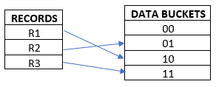
Hash File Organization – Dynamic Hashing
As we can see, no bucket is left for R3 record. Now, to accommodate R3, the bucket grows and changes the address to 2 bits rather than 1 bit.

Slide 46
Hash File Organization – Pros and Cons

Slide 47
Hash File Organization – Pros and Cons
Pros:
Record Access: Accessing a record is fast since the block address is known by hash function.
Ease in Operations: Records can easily be inserted, updated, or deleted.
Cons:
Space Wastage: Wastage of space if the number of records is less, as the records are randomly stored in different locations.
Range Involving Queries: Queries involving range of an attribute value will be inefficient if hash file organization is used.
Non-hashed Attribute Queries: Queries made on non-hashed attribute may require searching the entire table.

Slide 48

THANK YOU
Your Questions are welcomed!

